Slide 1
SQL Internship Project Overview
This SQL project was completed during my internship at Inlighn Tech. It involved designing a relational schema, importing CSV data, writing SQL queries, and exporting analysis results.
Project Completed by: Ansh Kaushik

Slide 2
Project Goals & Tools
Tools Used: PostgreSQL, psql shell, Excel (for CSV), and PowerPoint.
Objectives:
Design normalized database
Import real-world data
Write and optimize SQL queries
- Answer the Given Questions

Slide 3
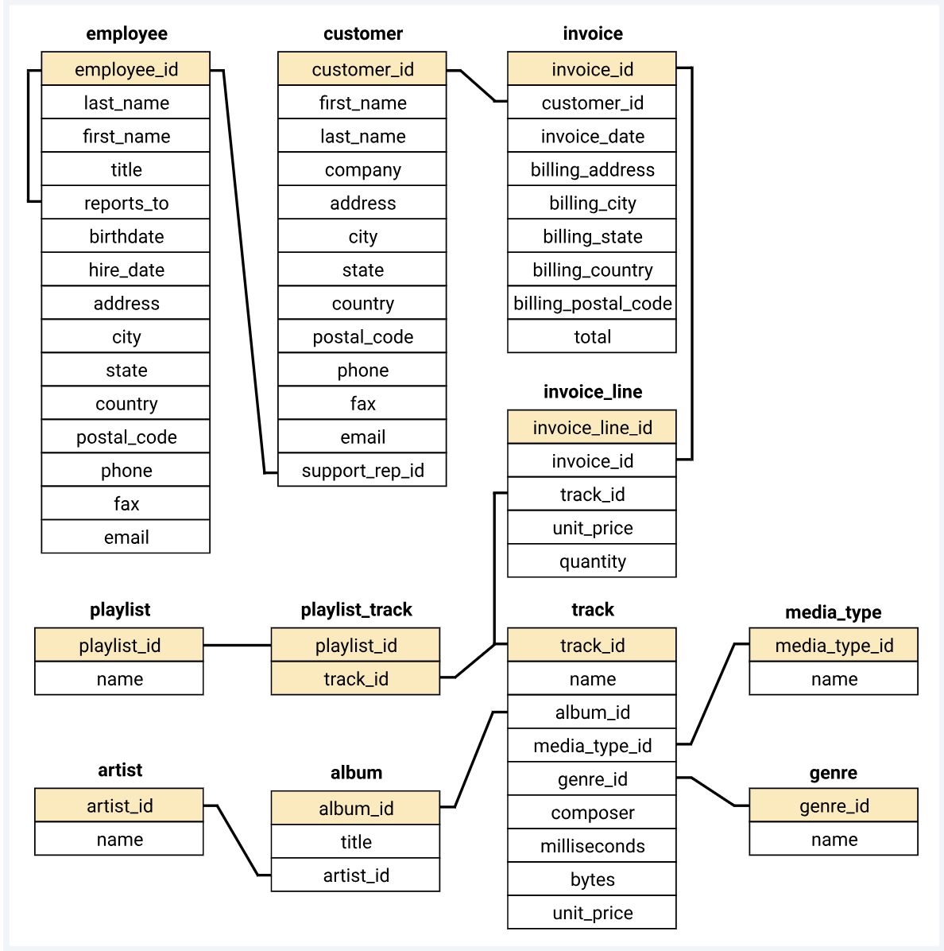
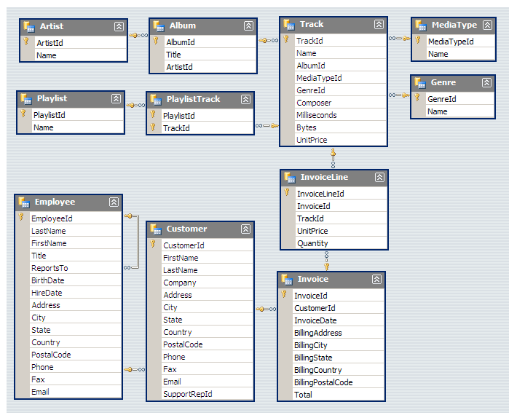
Database Schema & ERD
Schema includes Artist, Album, Track, Invoice, InvoiceLine, Customer, Employee, etc. Relationships defined via foreign keys.

Slide 4
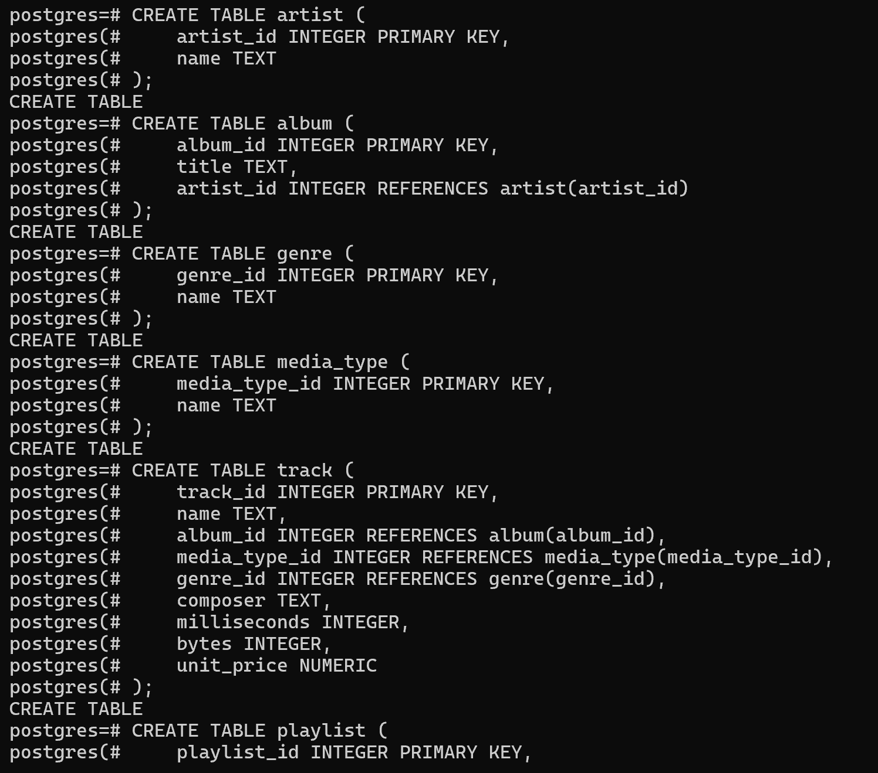
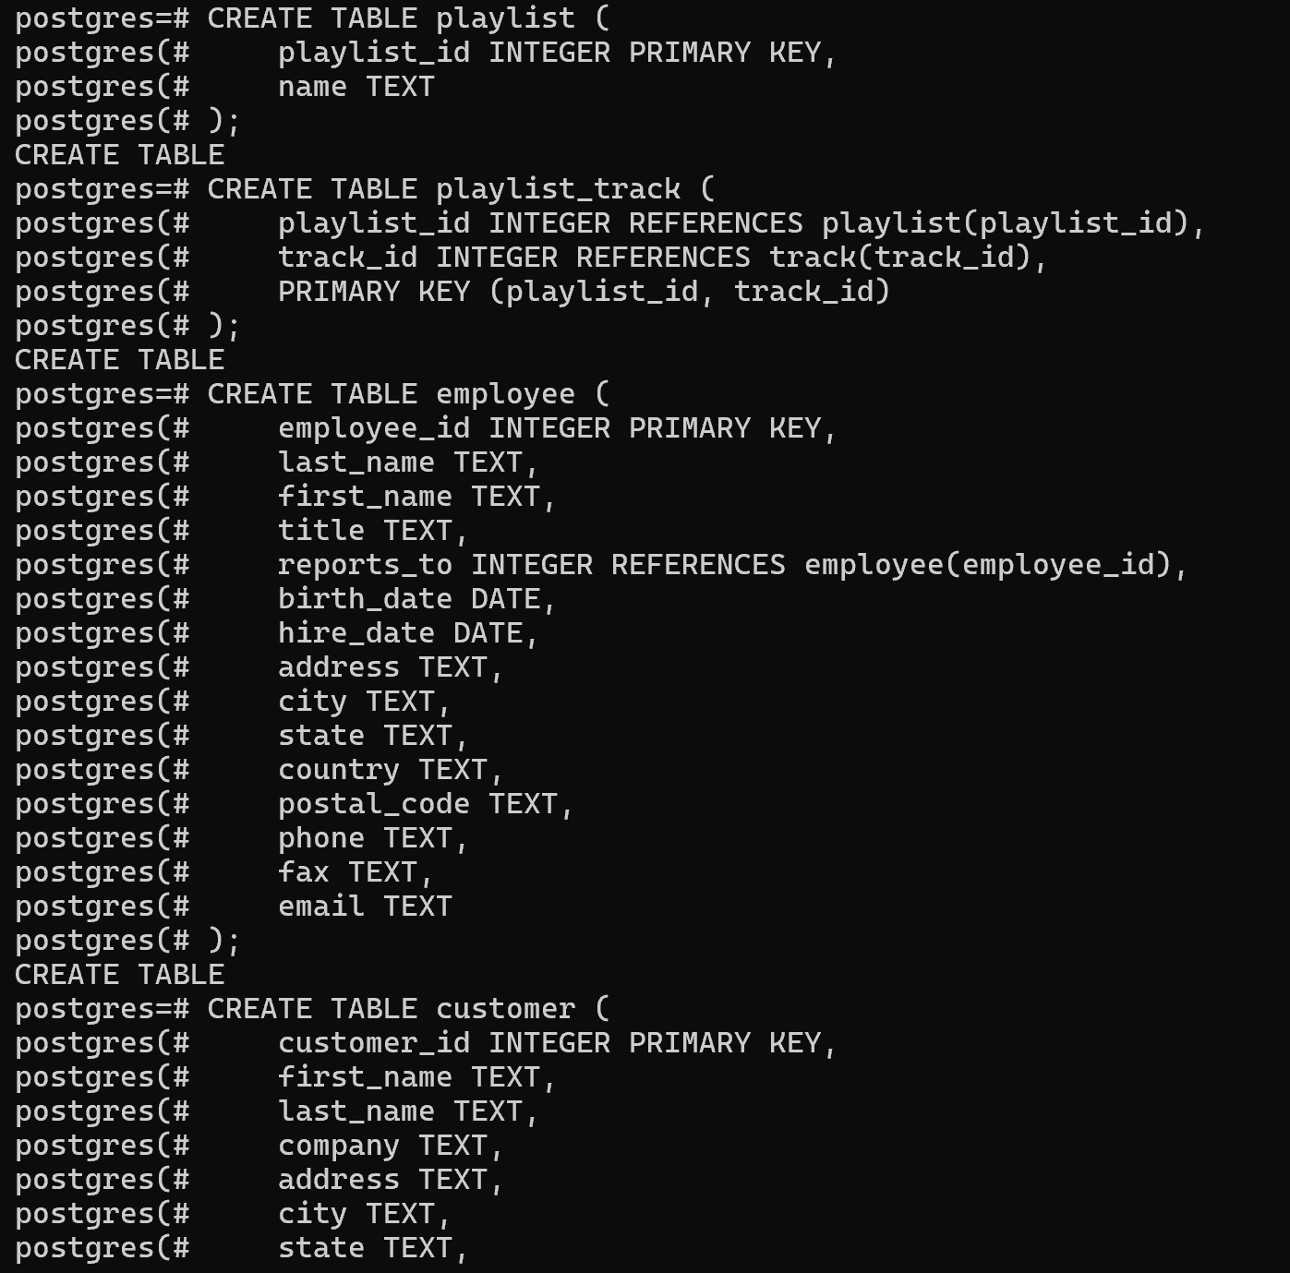
Table Creation (DDL Statements)
Used CREATE TABLE commands to define structure, primary keys, and foreign keys.

Slide 5
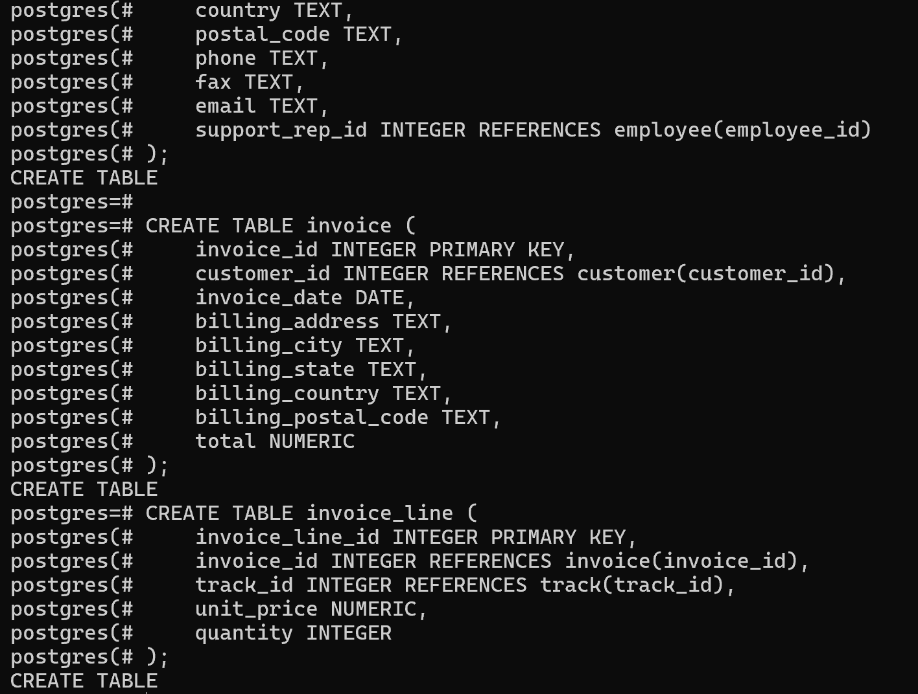
Data Insertion & Loading
Data imported using COPY/INSERT. Resolved encoding issues (UTF-8), column mismatches, and FK constraints.
📌 SQL DDL used to create core tables like Artist and Album with constraints.

Slide 6
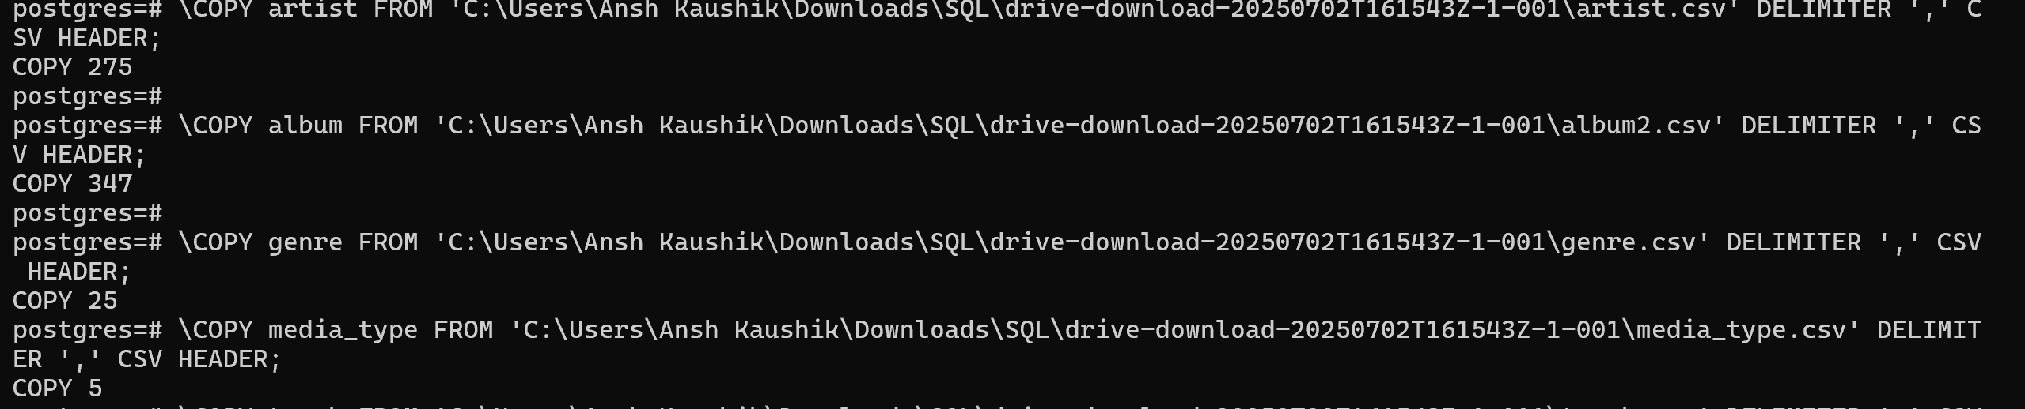
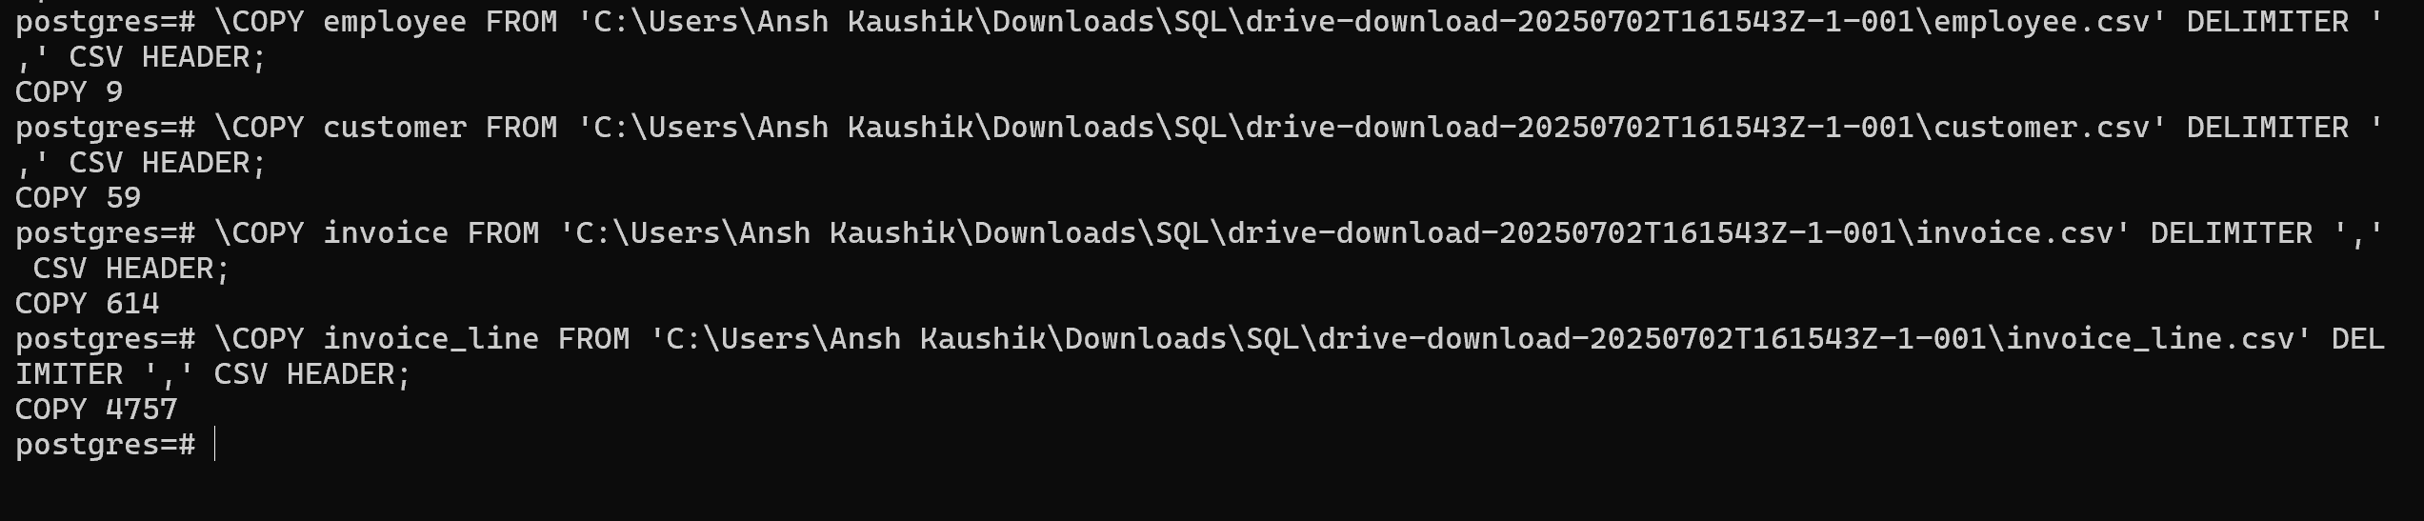
📌 CSV data imported using COPY. Solved encoding and column mismatch issues.

Slide 7
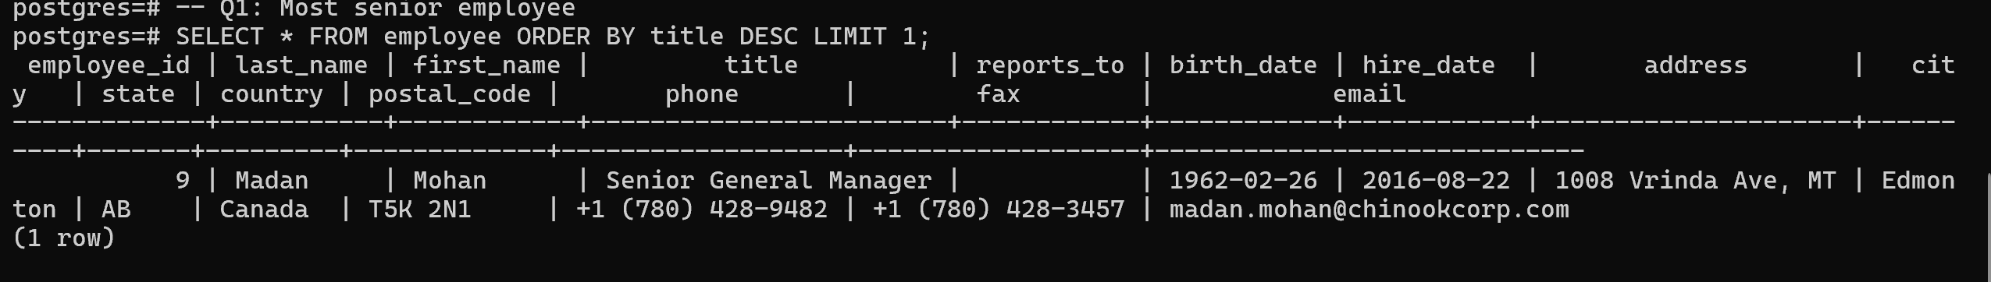
Easy-Level SQL Query & Output
📌 This query calculates total amount spent by each customer using joins and aggregation.

Slide 8
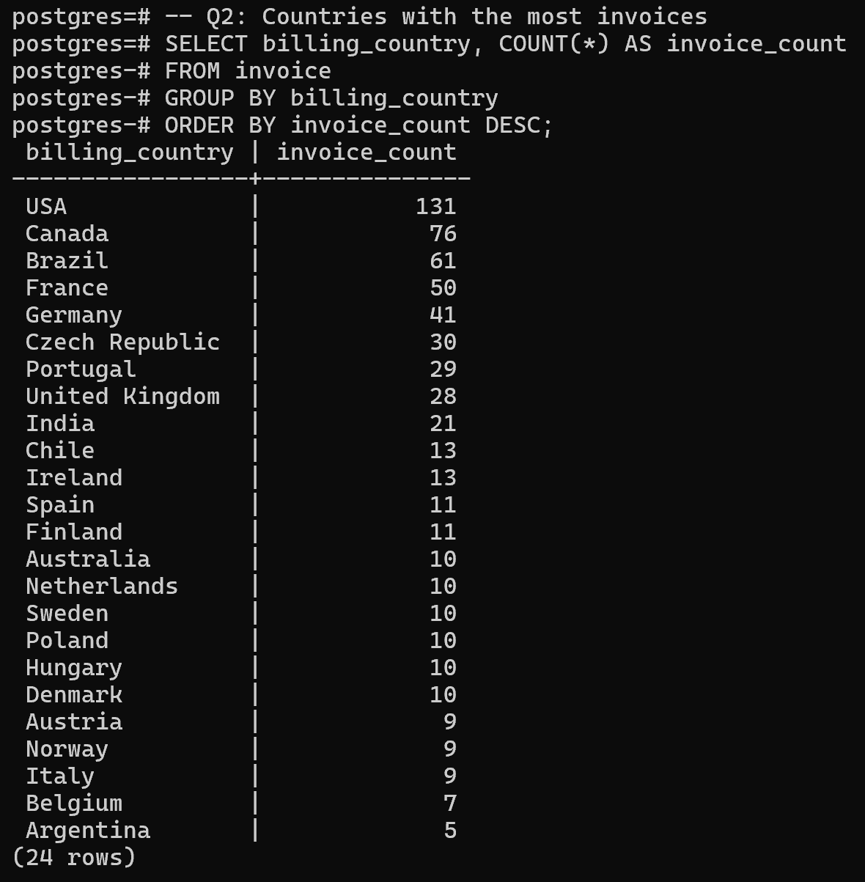
📌 Output of easy-level queries showing invoice totals and customer spending.

Slide 9
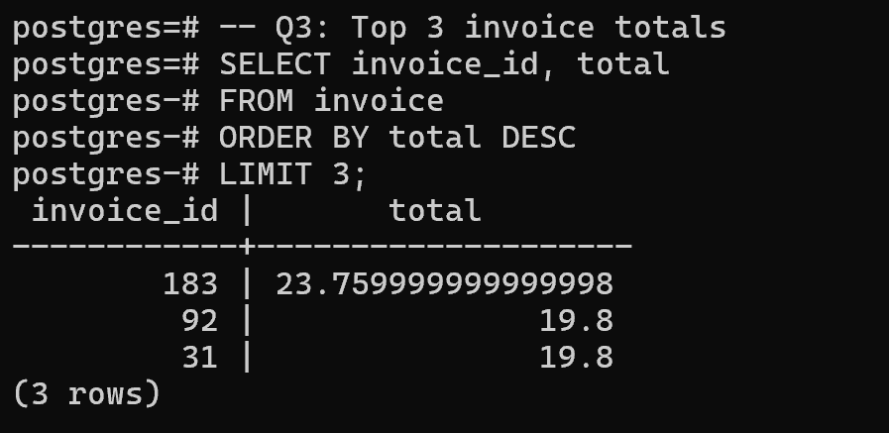
📌 CTE-based query linking customers and artists to calculate revenue per artist.

Slide 10
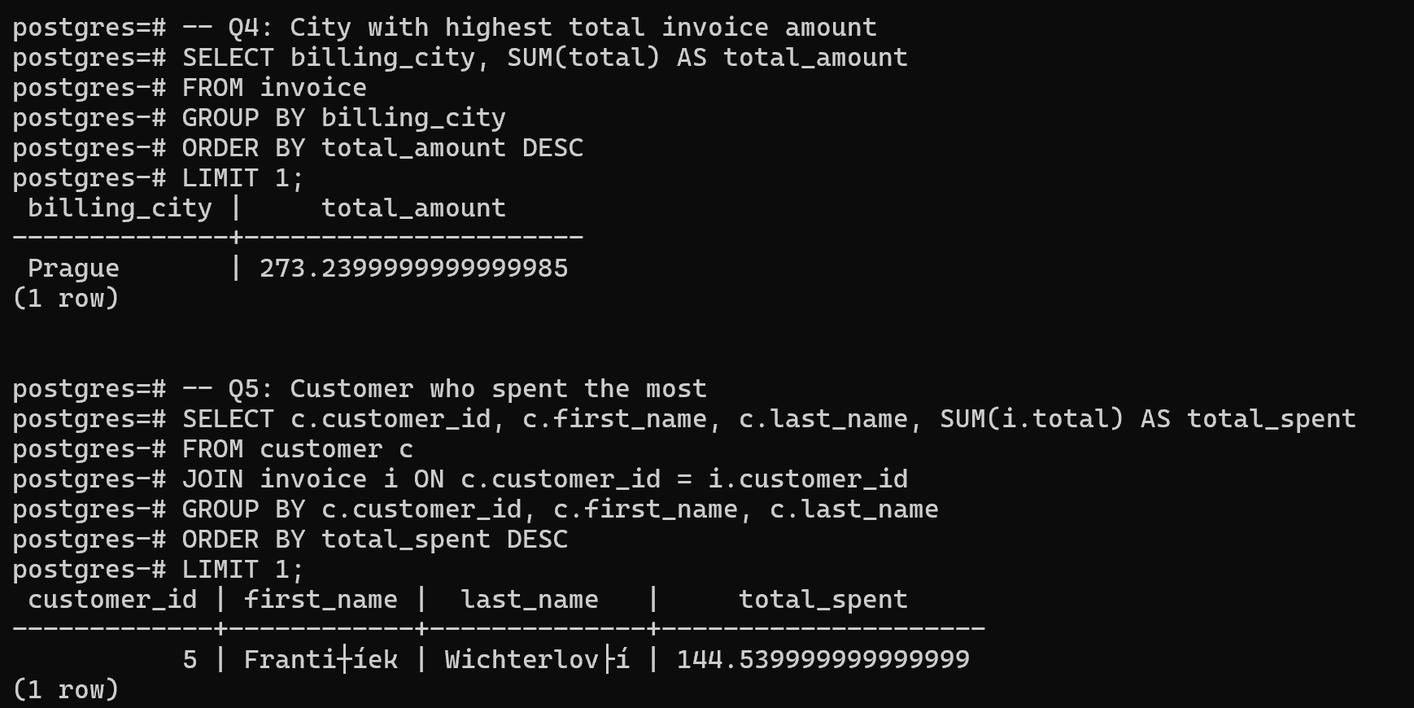
📌 Output shows grouped data of customer spending per artist across 2400+ rows.

Slide 11
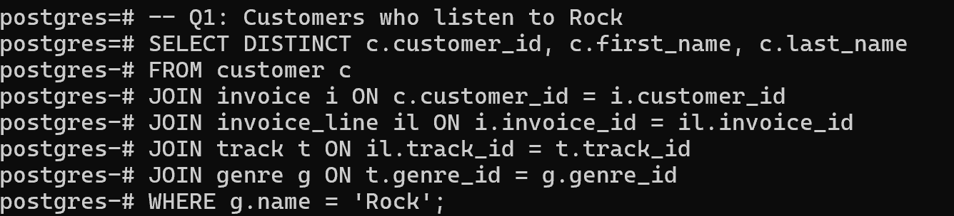
Moderate-Level SQL Query & Output
📌 Advanced nested query extracting top-spending customers per artist.

Slide 12
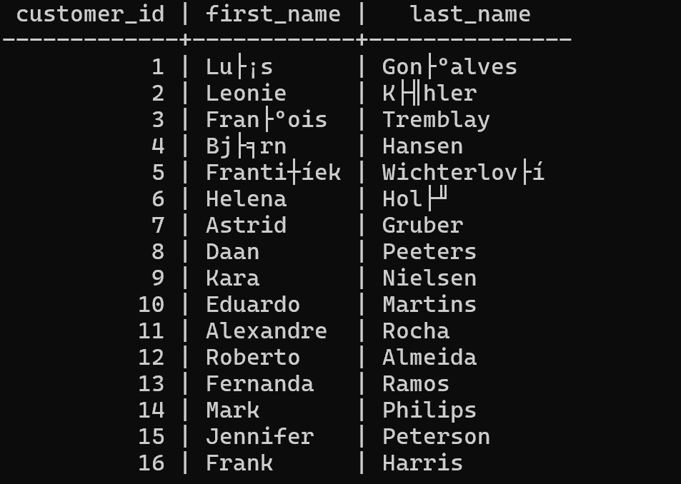
📌 Result exported to CSV using \COPY command from psql. Total 2140+ rows.

Slide 13
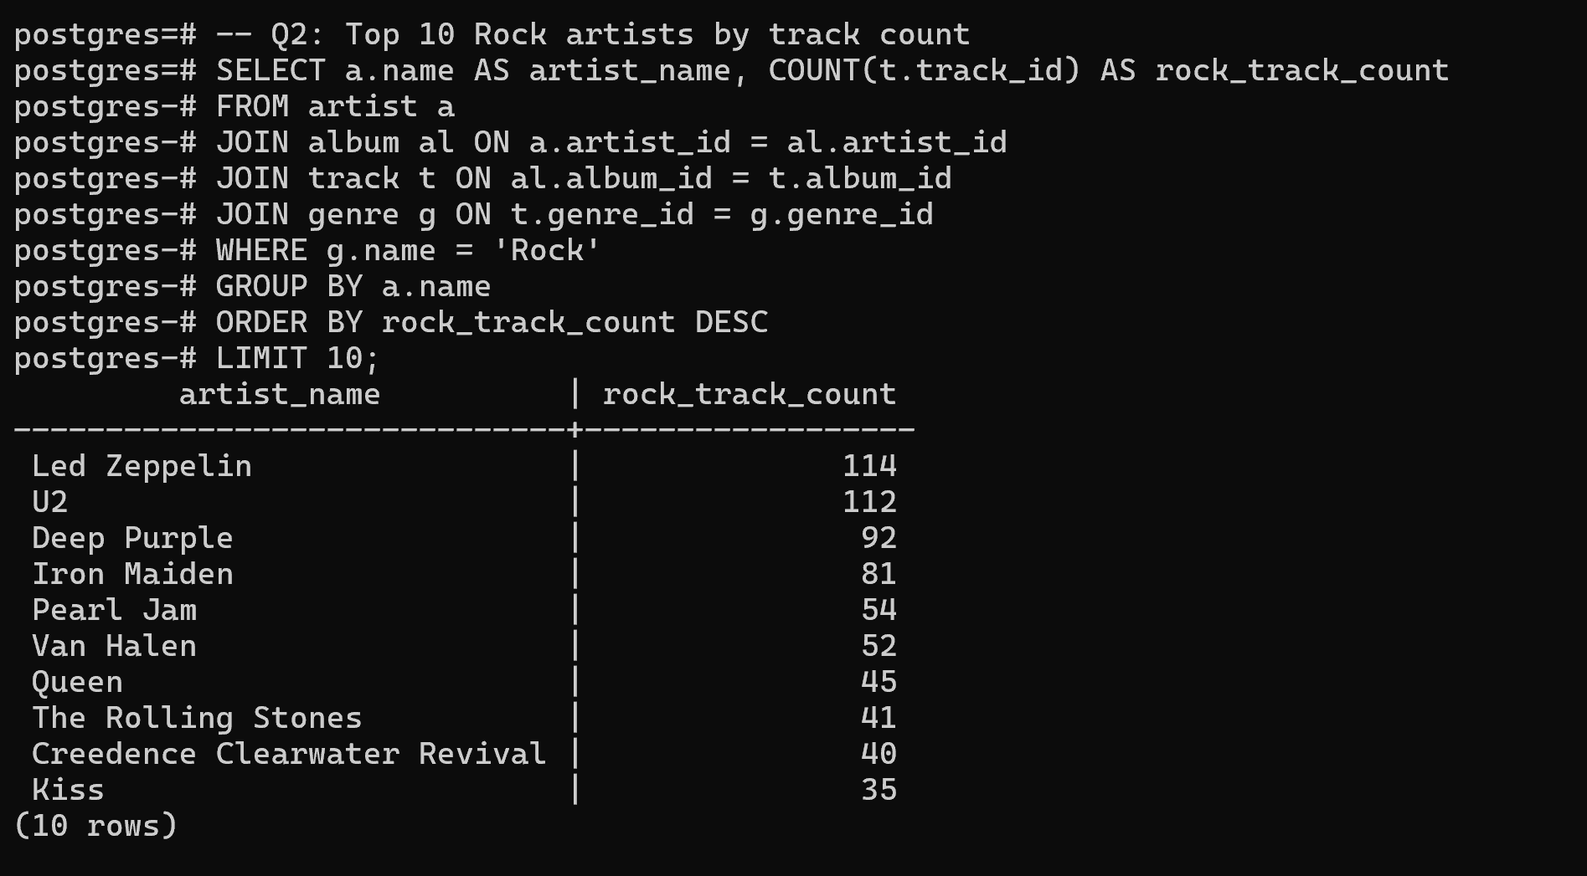

Slide 14
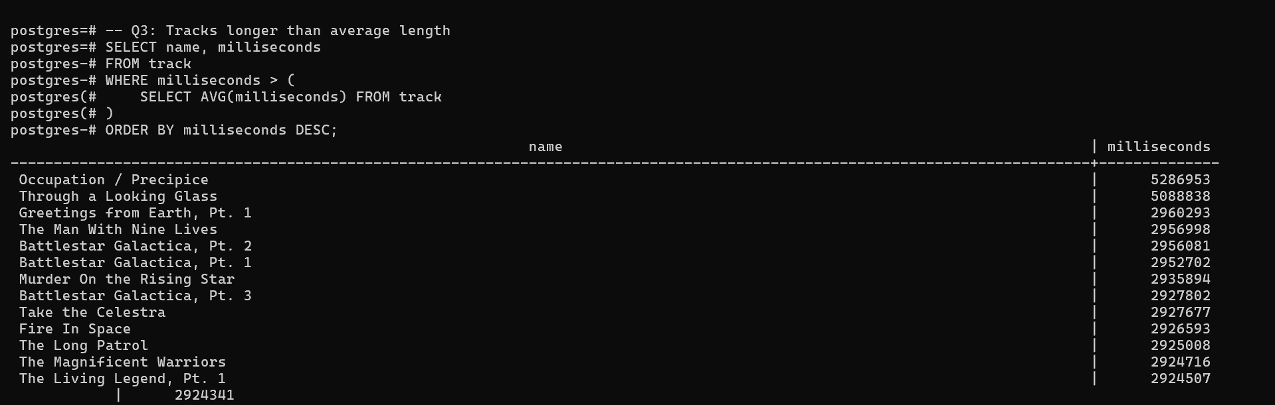

Slide 15
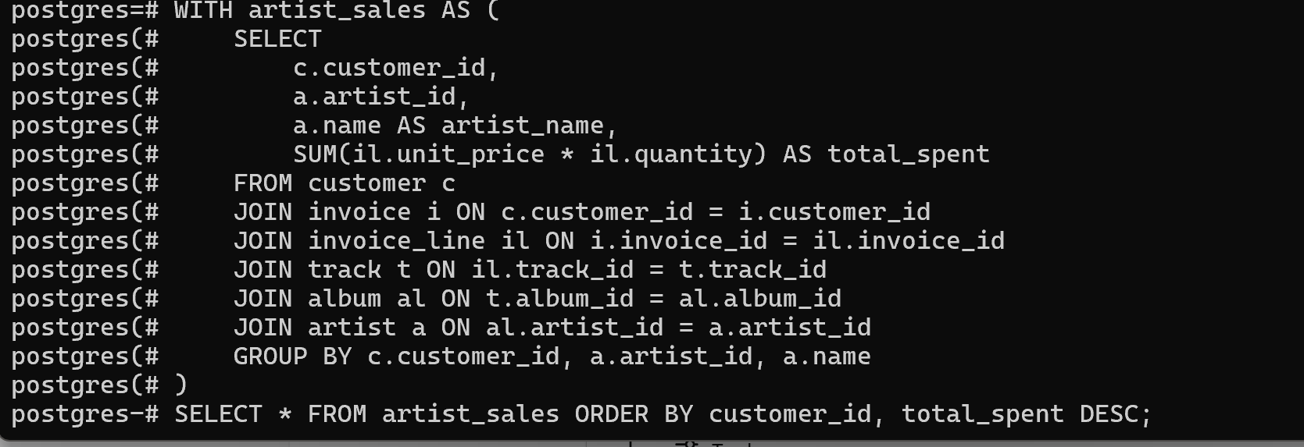
Advanced-Level SQL Query & Output
-- Q1: Customer spending per artist
Its answer is copied into a csv file(customer_artist_sales), it is submitted along this presentation

Slide 16
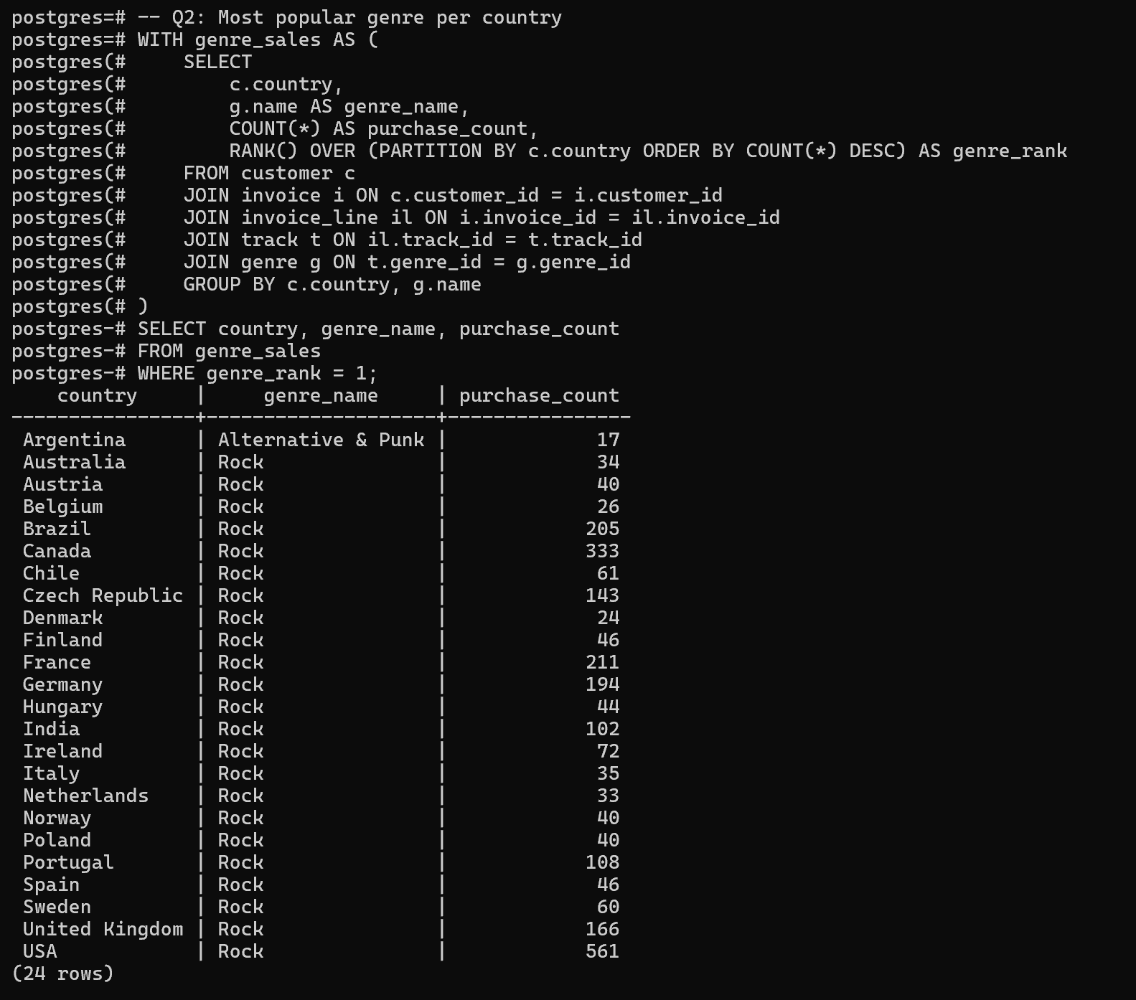

Slide 17
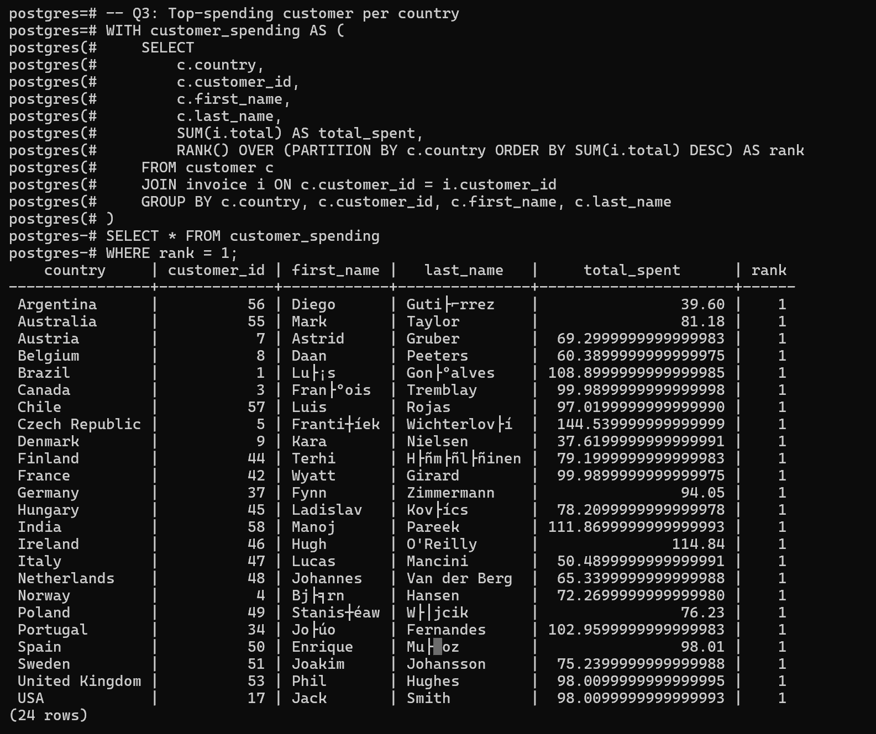

Slide 18
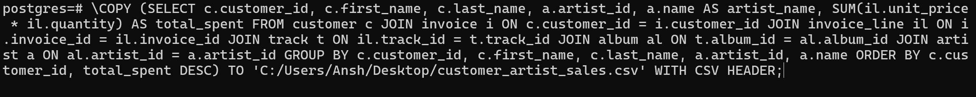
Exporting Query Results to CSV
CSV files were generated using \\COPY command in psql.

Slide 19
Challenges & Debugging
Issues resolved include encoding mismatches, FK errors, path permissions, and query returns.
Foreign Key Constraint Failures
Character Encoding Errors
Extra Data After Last Expected Column
Error: insert or update on table violates foreign key constraint
Error: character with byte sequence 0x81 in encoding "WIN1252" has no equivalent in encoding "UTF8"
Error: extra data after last expected column when loading employee.csv

Slide 20
Conclusion & Learnings
Learned: schema design, complex joins, SQL aggregation, real-world debugging. Internship experience summary.

